Slide 1
Battle Royale
Visualization
Visual images of the battle symbol

Slide 2

"What the hell did you do to Miss. Anno?" (page 30).
Miss Anno went missing, and questions were raised about her whereabouts. She had been killed after she refused to accept the assignment of a student. The quote accomplish the writer's motive, as it comes out as a symbol of fear that probably something wrong might have been done to Miss Anno. It is used in the book to create suspense and paint a picture of what might have ensued.

Slide 3
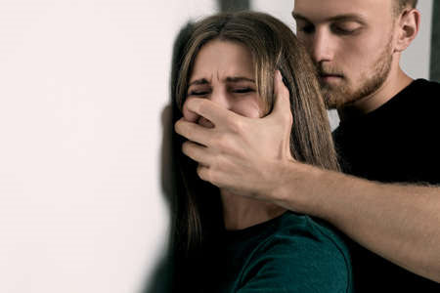
“Well, she was just as uncooperative as Mr. Hayashida was. Since none of them accepted your assignment, I had no choice but to use whatever means necessary to keep her quiet. In a quiet voice, Sakamochi said, "...abuse her. Don't worry about it. "She's not quite gone yet."
(Page 30)

Slide 4
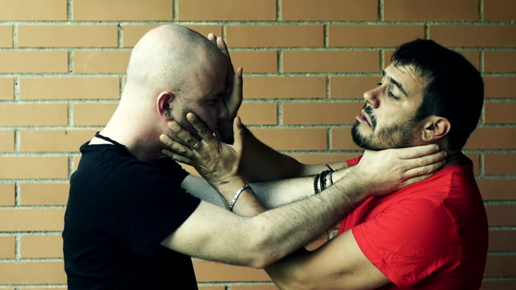
"You're going to die!" I roared. Yoshitoki refused to relent. He vowed, "I'll put an end to you, I'll put an end to you!"
(Page 31)

Slide 5
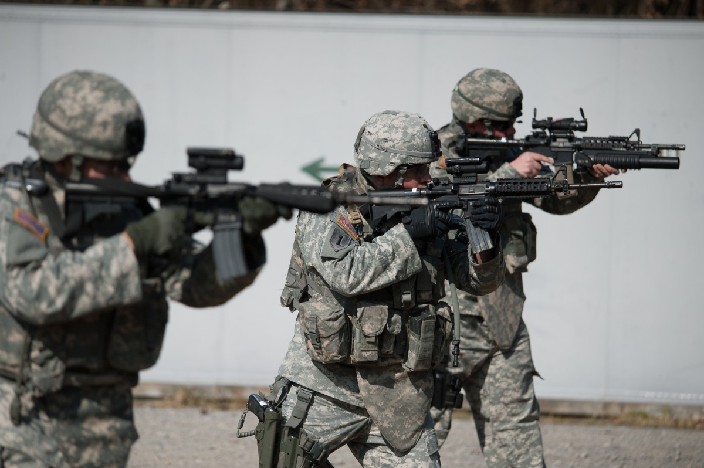
“The guns of the three troops were already cocked. His chest tightened as a result of the tightness in his throat. His buddy Yoshitoki Kuninobu was my friend, he remarked uncomfortably. I could at least shut his eyes. We're expected to honor the deceased, according to the education agenda of the Great Dictator."
Page 45.

Slide 6

“Was it possible—and if it was, how did they achieve it? Mayumi Tendo had barely left the school when someone came back to murder her.”
Page 49

Slide 7
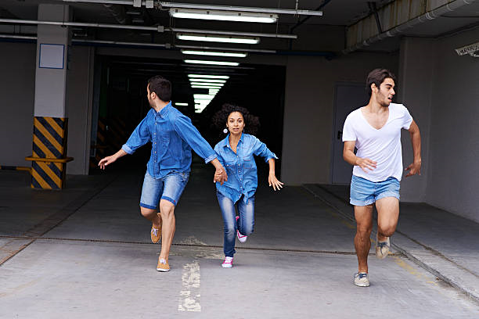
“We’re running! Do your best, you have to run!”
Page 50

Slide 8
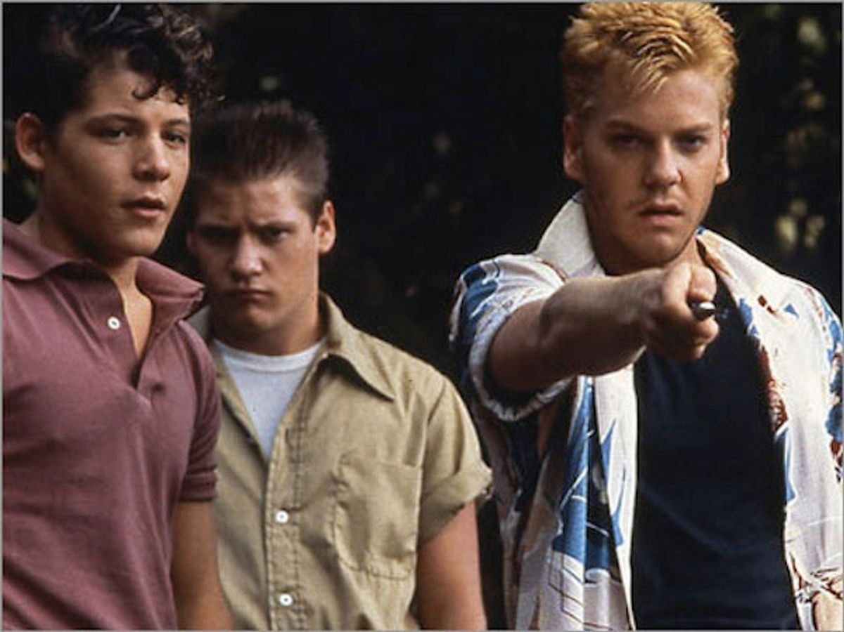
“We’ll have to teach you a lesson.” “Yes, we must.”
(Page 63)

